Slide 1
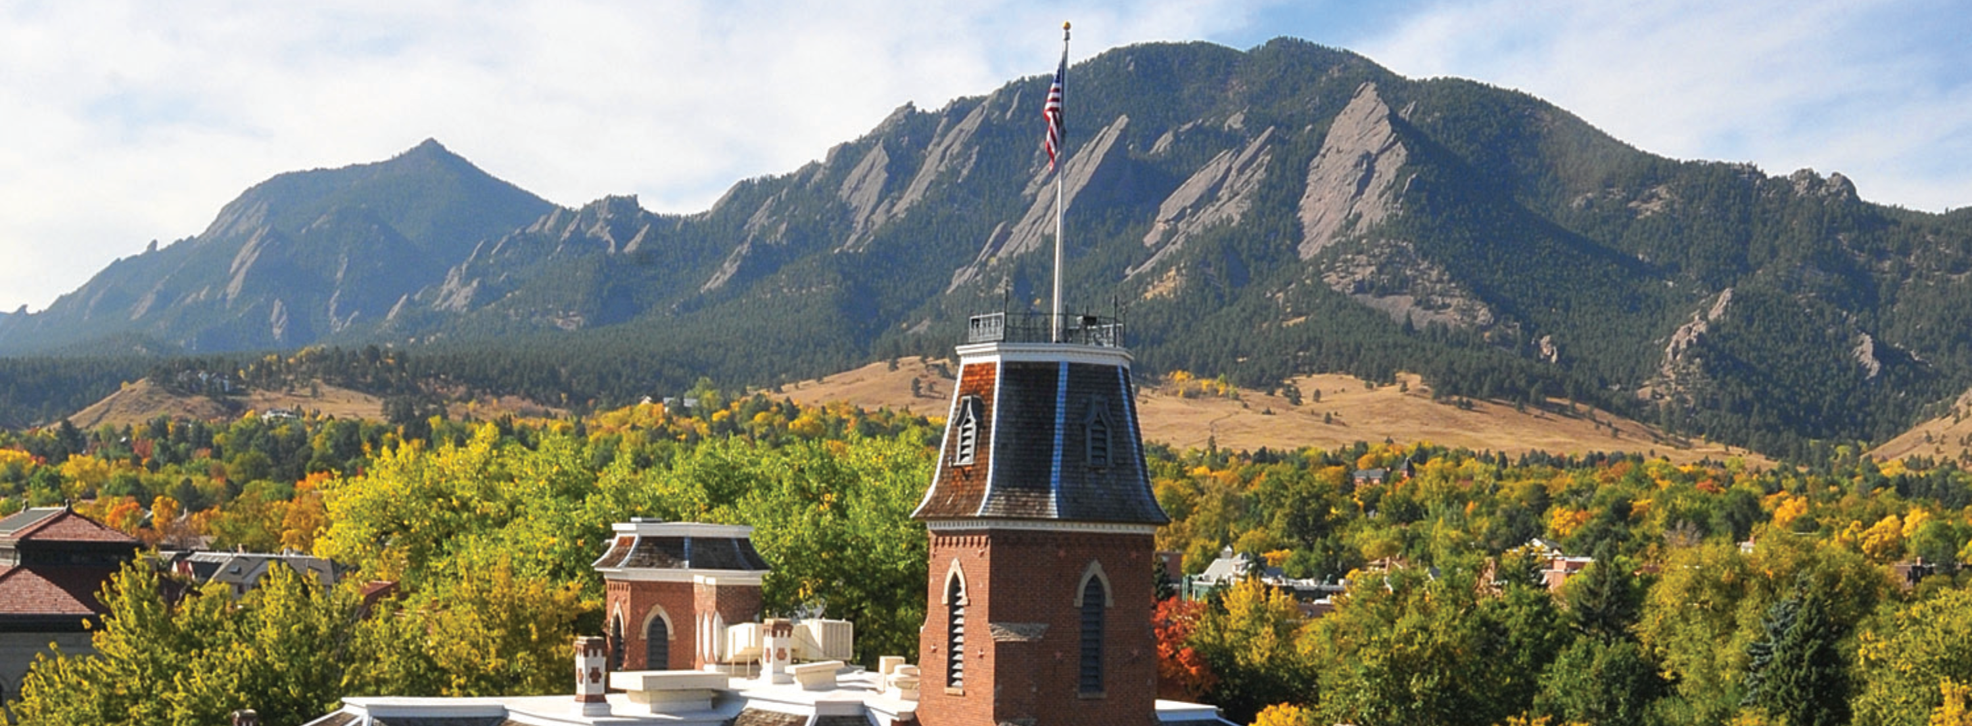
The “How-to” Guide to using CU PetaLibrary storage

Slide 2
Andy Monaghan (slides developed by Brandon Reyes)
email: rc-help@colorado.edu
RC Homepage: https://www.colorado.edu/rc
Slides available on GitHub:
https://github.com/ResearchComputing/petalibrary_howto_fall2023

Slide 3
Outline
Introduction to PetaLibrary
Getting A Petalibrary Allocation
Data transfer to/from PetaLibrary via graphical interfaces
Data transfer using Open OnDemand
Data transfer using Globus
Data transfer to/from PetaLibrary using the command line
scp, sftp, rsync
sshfs and smb
Sharing Data

Slide 4
The PetaLibrary
The PetaLibrary is a CU Boulder Research Computing (CURC) service
Expands the amount of storage space available to you (up to 100s of TB)
Is integrated with other CURC resources
Supports the storage, archival, publication and sharing of data
Available at a subsidized cost for researchers affiliated with CU system
Available at full cost for external researchers

Slide 5
PetaLibrary Do’s and Don’ts
The PetaLibrary is a CU Boulder Research Computing service
Do:
Store research data on PetaLibrary
Do not:
Store confidential, or HIPAA, or ITAR-controlled data on PetaLibrary
Store personal data on PetaLibrary
Terms of service: https://www.colorado.edu/rc/resources/petalibrary/tos

Slide 6
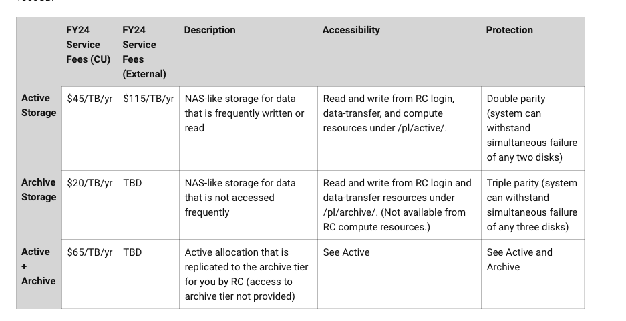
PetaLibrary Tiers

Slide 7
Requesting a PetaLibrary allocation
Visit https://www.colorado.edu/rc/resources/petalibrary
Select Request a New PetaLibrary Allocation

Slide 8
GUI based data transfer options

Slide 9

GUI option - Open OnDemand
No command line required!
http://ondemand.rc.colorado.edu/
http://ondemand-rmacc.rc.colorado.edu/
File management
Create, Delete, Move, and Rename
File transfers
Upload and Download

Slide 10
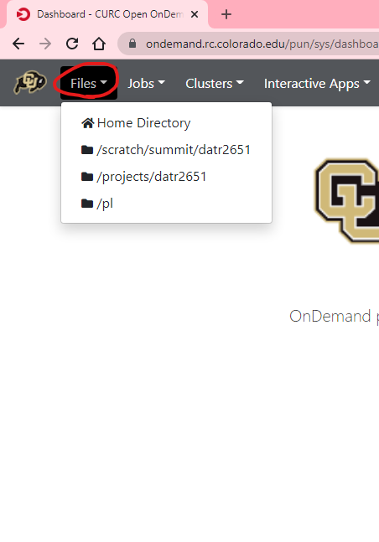
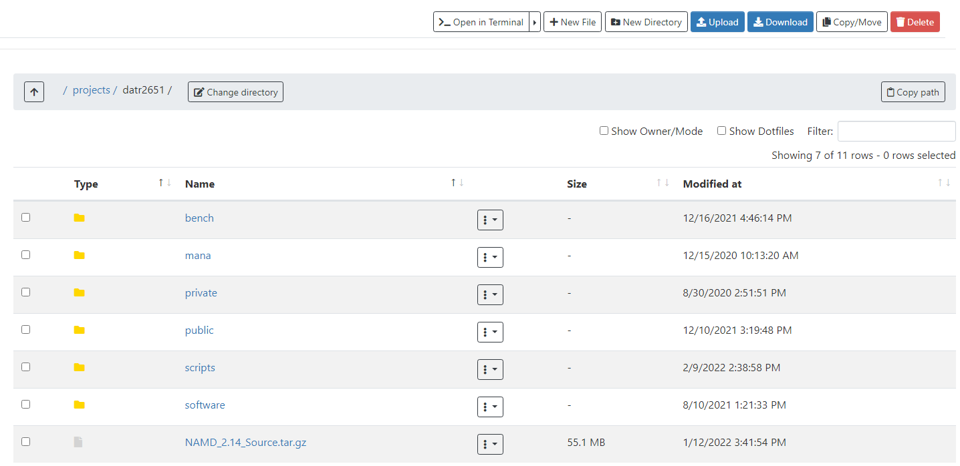

Slide 11
Let’s take a look!

Slide 12

GUI option - Globus
Globus is a service that allows for users to reliably move, share, and discover data
Command line version is also available
Our recommended way to transfer data
Stable and fast data transfers
Transfers continue if a user disconnects
Web GUI or Globus Connect Personal GUI
Supported on all major operating systems
Works well with cloud storage providers

Slide 13
Globus Demo
Globus login is simple and quick: https://app.globus.org
CU Boulder users - select “University of Colorado at Boulder” in the dropdown menu
Other institutions should select “ACCESS”
Login with your credentials
Continue with onscreen prompts until you are brought to the Globus WebGUI
Installing a Globus Endpoint on your local machine
Required if you want to transfer data to your machine
Navigate to https://www.globus.org/globus-connect-personal
Click on operating system specific version and follow install instructions

Slide 14
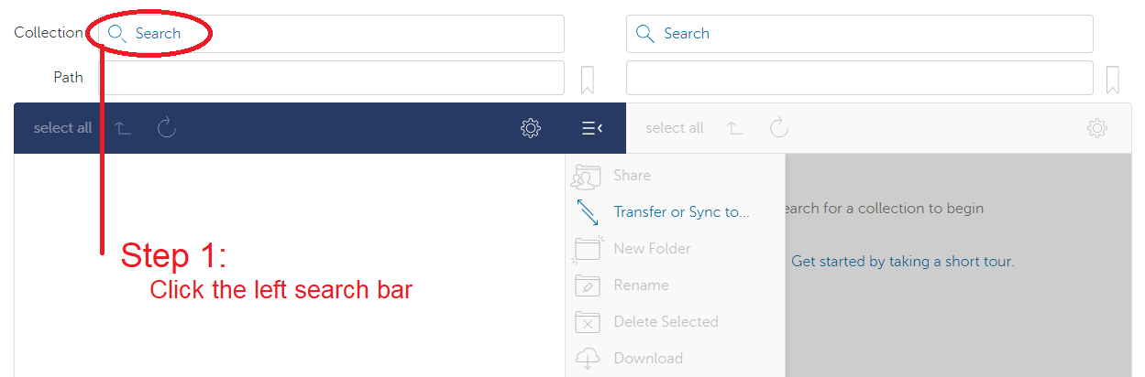
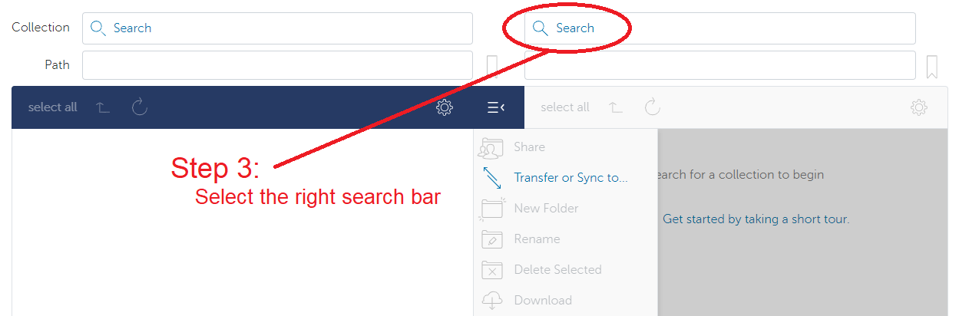
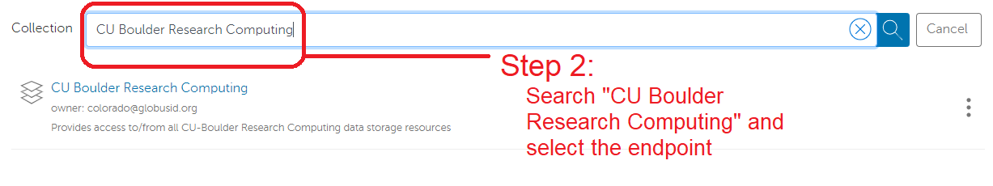
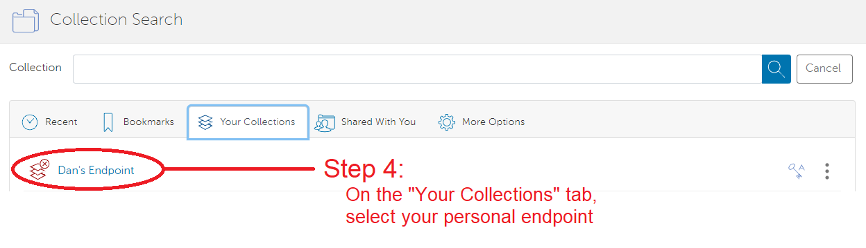

Slide 15
Let’s check it out!

Slide 16
Command-line based data transfer options

Slide 17
RC endpoints
Endpoint – one of the two file transfer locations i.e., it is either the source or the destination we want to copy data from or to.
For data on RC resources, we have two endpoints
The login* nodes (Only use for small transfers!!)
For RMACC (@xsede.org) accounts:
Data transfer nodes (DTNs)
<your-username>@login.rc.colorado.edu
<your-username>@login-ci.rc.colorado.edu
<your-username>@dtn23.rc.colorado.edu

Slide 18
RC Data transfer nodes (DTNs)
Command line use of DTNs only available if you are on CU Boulder or CSU’s network or VPN
Dedicated nodes for transferring data
Faster transfers
More stable transfers
Suitable for
Large and frequent transfers
Automated (passwordless) transfers
Only for CU Boulder folks
Cannot ssh into the DTNs!

Slide 19
Command line option: scp, sftp, rsync
SCP (Secure Copy Protocol) is a command line tool to transfer files/directories to, from, or between remote locations.
Simple, but useful!
Copying a local file to RC resources using a login node:
scp file1 <username>@dtn23.rc.colorado.edu:<remote-path>x
sftp <username>@dtn23.rc.colorado.edu
rsync file1 <username>@dtn23.rc.colorado.edu:<remote-path>x

Slide 20
Command line option - Rclone
Rclone is a command line tool used to manage files on cloud storage.
It is compatible with all major cloud storage solutions
Supported by over 40 cloud storage products!
Created as a cloud equivalent to the UNIX commands:
rsync, cp, mv, mount, ls, ncdu, tree, rm, and cat
Needs to be downloaded on your local machine
Requires a more involved setup process but works great!
https://curc.readthedocs.io/en/latest/compute/data-transfer.html#rclone
rclone copy rclonetest.csv aws_s3:testbucket/

Slide 21
Command line option - mounting
Mounting is the process of attaching a file system to a directory on another system.
SSHFS (secure shell filesystem)
Needs to be installed on Mac and Windows (available on most Linux distributions)
You need to be on the campus network or VPN!
SMB (server message block)
Built into all major operating systems
You need to be on the campus network or VPN!
Contact us if you want to use this
sshfs <username>@dtn23.rc.colorado.edu:<path> <local-mountpoint>

Slide 22
Sharing Data
RC Users on RC resources
Send a request and a list of the users to rc-help@colorado.edu
RC will place the chosen users in your Linux group
Allows them to see your scratch and project directories
You can set permissions in the space, so items are hidden
On-premise collaborators can also access Petalibrary files with Globus Shared Endpoints
Off-premise collaborators
Data sharing is only available if you have a PetaLibrary allocation
Data transfer is done through Globus Shared Endpoints…

Slide 23
Globus Shared Endpoints
Globus offers ‘shared endpoints’ which don’t require a user to have an account with RC.
RC provides this capability for easy access of Data.
PetaLibrary exclusive!
Generates a shared collection that can be accessed with a link.
See https://scholar.colorado.edu/concern/datasets/9593tw13k
Can assign various permissions to specific users or all users withing Globus
More information on here: https://docs.globus.org/how-to/share-files/

Slide 24
Thank you!!
For more help contact rc-help@colorado.edu
Additional documentation: https://curc.readthedocs.io/en/latest/compute/data-transfer.html
Survey: http://tinyurl.com/curc-survey18

Slide 25
General Filesystem Structure
/home (2GB) | /projects (250GB) | /scratch/alpine (10TB)
Small important data Backed up frequently Not for sharing files or job output | Medium sized important data Software Can be shared with others Backed up, but less frequently Not for job output | Large data Can be shared with others Fast Data transfer to compute nodes Not backed up! Purged after 90 days!
Filesystem documentation: https://curc.readthedocs.io/en/latest/compute/filesystems.html

